Slide 1

MICROSERVICES
Prachitee Maratkar
Medha Shaharkar
Mentor : Deviprasad Tummidi
Team : IB-IT-GED RISK

Slide 2
Monolithic Application
Application Server
Deployment
UI
Service

Slide 3
Inflexible
Large & complex applications
Unscalable
Slow development
Unreliable
Blocks continuous development
Challenges

Slide 4

MICROSERVICES
UI MICROSERVICE
Client
MICROSERVICE
1
MICROSERVICE
2
MICROSERVICE3

Slide 5


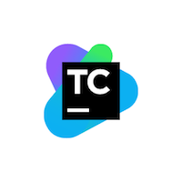


GITHUB - TEAMCITY - DOCKER PIPELINE
Packaging the application using maven
Generating Docker image
Publishing image to Docker registry
Pulling the image and running a container
Developers
Commit
Yay! The Application is up and running in no time !
Here GitHub is used as a source repository
Teamcity is a continuous integration platform. We define different build configurations.
Commit polling
Build detected
Teamcity Build Agent

Slide 6
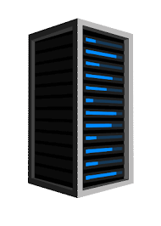
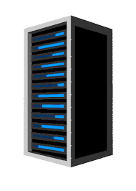
AUTOMATION OF MIGRATION OF DEPENDENCIES
.jar
.pom
.jar
.jar
xstm1010dap
Nexus-london

Slide 7
Q&A

